Slide 1
R Programming
For Data Science

Slide 2
Topics
Getting Started
Data Types
For Loops
Functions
Import & Export
Table Checking and Manipulation
Merging Tables
Summary Statistics

Slide 3
Getting Started

Slide 4
Installation
Installing R is fairly straightforward, you should have an R executable on your machine named R-x.x.x-win.exe – run this and accept the defaults
We’re going to use RStudio as our IDE so install this as well
Be sure you are using RStudio not RGUI
You can just write R scripts in a text editor like Notepad++ and import that in to RStudio (which we will cover later)

Slide 5
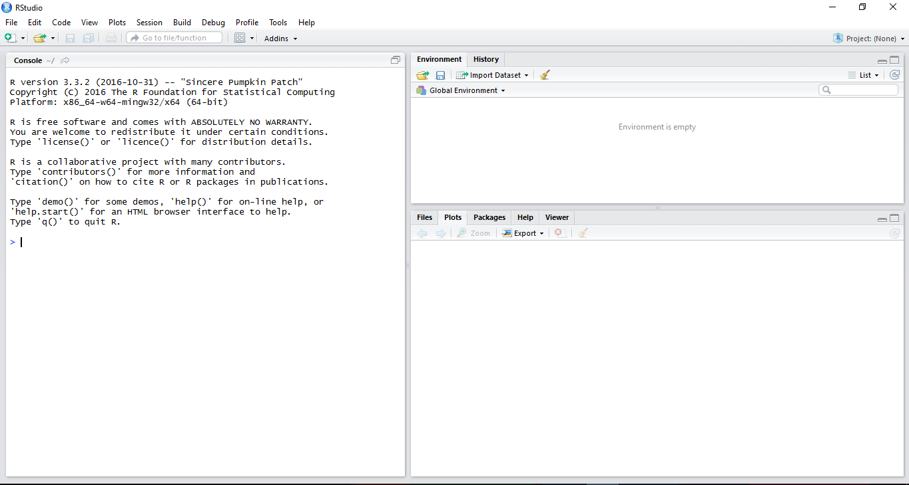
Notes:
You can type directly in to the console, same as you would on a command prompt
Or you can open a script – do this by clicking on the button with the green plus at the top left for a new one. This way you can keep code for future use.

Slide 6
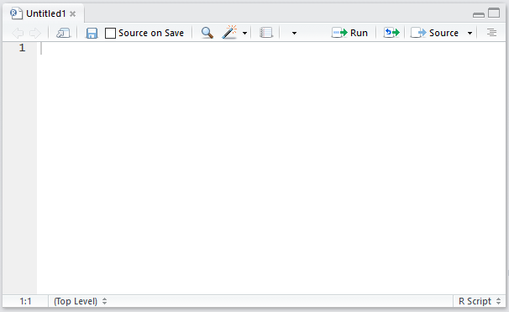
Notes:
This is where you can create scripts, it auto appears in the top left but you can move it
Notice also the ‘source on save’ button. If you use this, any functions you save in here will be automatically available on the console!

Slide 7
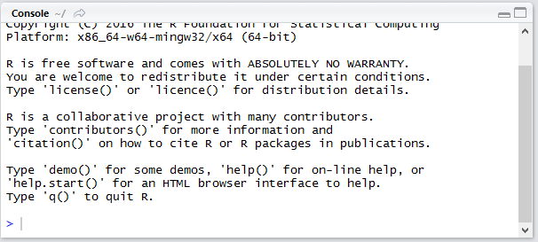
Notes:
Console for ad hoc analysis, checking things work etc

Slide 8
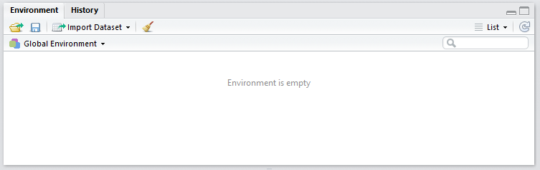
Notes:
Environment displays any variables or functions you have available in the console
So if we defined a function called ‘add’ and a variable called ‘x’ they would appear here to remind us what we can access
History lists every command you have entered during this session

Slide 9
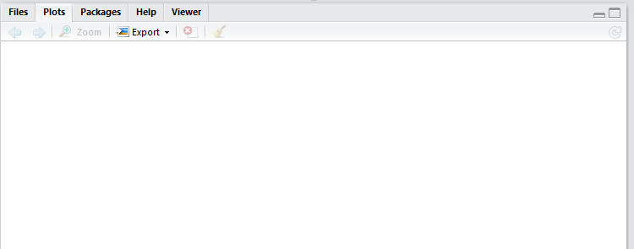
Notes:
Bottom right is a misc area
Files let’s you browse your file system for stuff
Plots is where any plots you generate with R will appear. Here is where you can zoom, save, etc
Packages lets you install additional packages including a brief description. There are many other packages it doesn’t list.
Help tab has a useful directory with information. To get help on a specific command, prepend the command with a question mark like ?data.frame
Viewer is a built in browser allowing you to develop and launch web apps locally

Slide 10

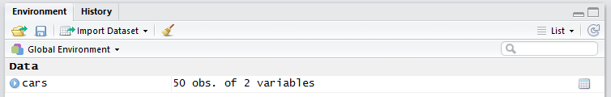
Data
RStudio comes with some nice data already there for us to experiment with, let’s load a bit to get used to R
To see a full list of available data type data() on the console
We’ll start with the cars data so type data(“cars”)
You should notice cars pop up in the Environment tab with ‘<promise>’ next to it – this means R hasn’t yet loaded the data in to memory, but that it will when you need it
Type cars to print out the data to the console (you can type the full print(cars) if you prefer)
After doing this you should notice the Environment variable change to say how many objects it contains
Notes:
Click the blue arrow to expand it and have a look at the data in the Environment tab

Slide 11
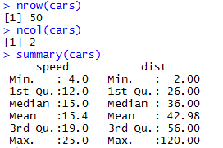
Getting Started
It’s really quick and easy to start exploring data in R

Slide 12
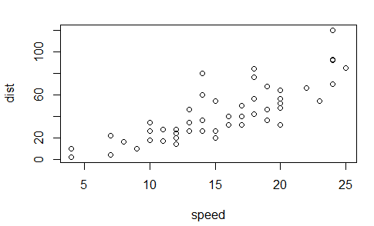
Getting Started
You can ever start plotting really quickly, all this took was a command that said plot(cars)

Slide 13
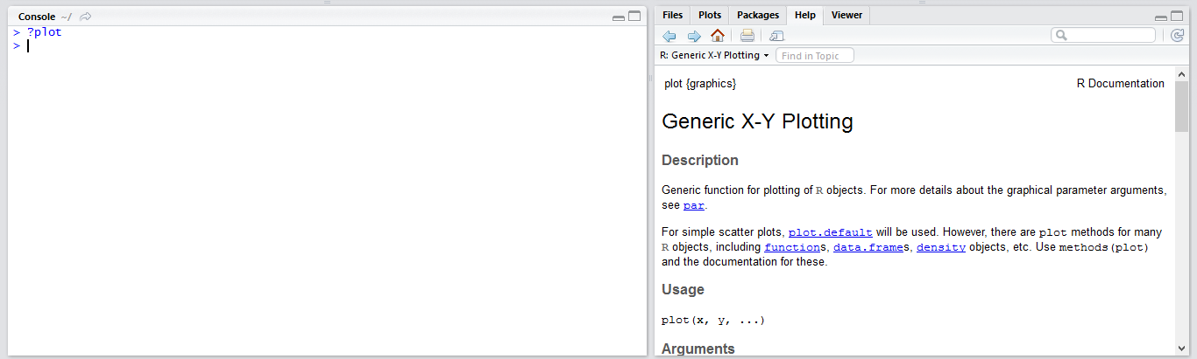
Getting Started
If you’re ever not sure what a function does, just type a question mark followed by the function name into the console and R will try to help

Slide 14
Data types

Slide 15

Assignment operator
In many languages the assignment operator (the thing we use to say this variable is equal to this value), is the equals sign e.g. x = 5
In R you can use the = sign on the console but you should really get used to the regular arrow convention!
In R, you should generally use x <- 5 for assignment

Slide 16
R Syntax
Character – typical string class, a set of one or more letters – “Hello world”
Numeric – like float, it can handle numeric values with decimal points – 5, 5.5, -5234.342342
Special numbers include NaN (Not a Number) and Inf (Infinity)
Integers – numbers get auto changed in to numerics when saved as variables but you can force them to be integers in a couple of ways
myInt <- 5 followed by myInt <- as.integer(myInt)
myInt <- 5L
If you try and change a number that is too large for an integer to hold it will still exist as an integer but no longer hold a value. It will display ‘NA’ which stands for Not Available
Complex – for complex numbers e.g. the imaginary number i

Slide 17
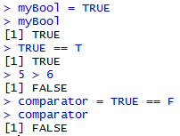
R Syntax
Logical – boolean types that can be either TRUE, T, or FALSE, F
You can convert numeric values to Logicals – 0 and 0L give F, anything else is T

Slide 18
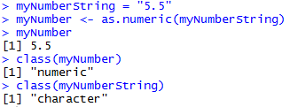
R Syntax
You can check the type of a variable using the class() method
Some data types can be converted

Slide 19

Higher types
Higher types are composed of lower ones
Vector – a collection of elements of the same type e.g. the cars dataset has columns with collections of numbers
Usually created with the concatenate (c) function
You’ll notice here when you print out a long piece of information R gives you some additional details in brackets []
These correspond to what element number is being displayed first on that line
Doesn’t have anything to do with the way the data is stored, just how it is being displayed
Notes:
This vector example is made up of characters

Slide 20
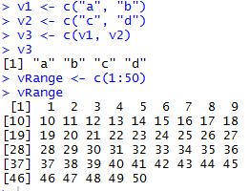
Higher types
Vectors are one dimensional, you cannot have a vector of vectors
You can concatenate two vectors into one long one if they have the same type of elements
You can also quickly mock up numeric vectors by using a range

Slide 21
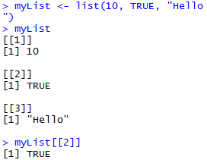
Higher types
Lists are similar to vectors but they can hold multiple different types in the same list
Can also only be one dimensional, if you try to add two lists they will just merge
The [[N]] value represents where in the list that particular value appears and you can access those values by specifying that value

Slide 22
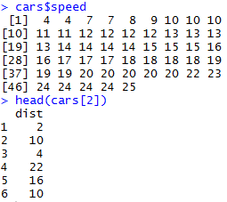
Dataframe
The cars data we got earlier is stored as a dataframe – these function much like tables with rows and columns
You can access specific columns using the $ operator or by specifying the number of the column
head and tail functions will return the first/last 6 values respectively
Notes:
If you access using a double square bracket then you get a numeric vector instead of a column
So head(cars[[2]]) returns:
2 10 4 22 16 10

Slide 23
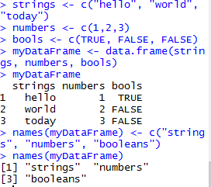
Dataframe
Dataframes are essentially a list of vectors of equal length
You can create Dataframes with the data.frame() function
You can change column names as needed

Slide 24
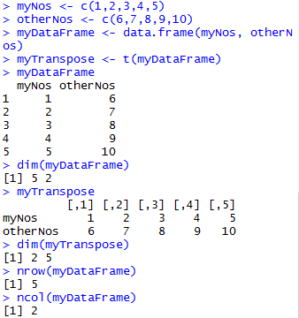

Dataframe
You can access columns in dataframes using the $ sign or using square brackets for rows and columns
The t() function transposes your dataframe, that is, the rows become the columns and columns become the rows
The dim() function returns the dimensions of the dataframe
Notes:
myDataFrame[1:10,]
Indicates return first 10 rows, all columns
myDataFrame[,1:3]
Would indicate return all rows, but just the first 3 columns
Length(myDataFrame) will also return the ncol value

Slide 25
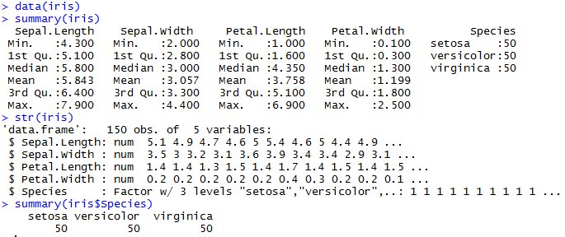
Dataframe
The summary() function will return a number of statistics about what you have presented (be it the full table or just a column) and str() tells you the structure of your dataframe
Notes:
myDataFrame[1:10,]
Indicates return first 10 rows, all columns
myDataFrame[,1:3]
Would indicate return all rows, but just the first 3 columns
Length(myDataFrame) will also return the ncol value

Slide 26
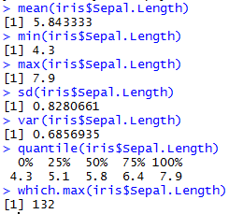
Dataframe
You can get even more specific and just extract exactly what you need
Which.something() will return the first element to fulfil the given function
Notes:
myDataFrame[1:10,]
Indicates return first 10 rows, all columns
myDataFrame[,1:3]
Would indicate return all rows, but just the first 3 columns
Length(myDataFrame) will also return the ncol value

Slide 27
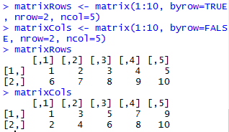
Matrix
Matrices are quite similar to Dataframes in that they are multidimensional vectors, but they can only contain values of the same type
When creating matrices you can indicate how many rows/columns you want to have and whether the matrix should be filled by the rows or by the columns (affecting how the data will look)

Slide 28
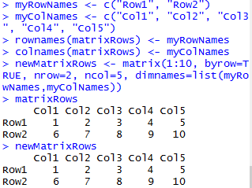
Matrix
You can also add names for the rows and columns of a matrix, either by specifying them in the creation of the matrix or later

Slide 29
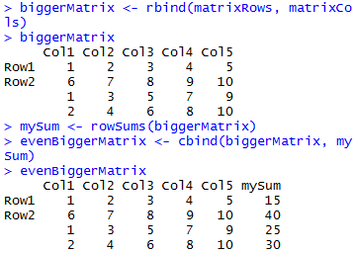
Matrix
You can add vectors and matrices together for new columns or rows using the cbind() and rbind() functions respectively
You can also perform arithmetic functions on these structures
For example summing by row or column using rowSums() and colSums()

Slide 30

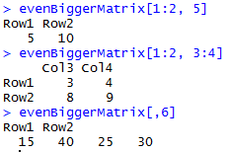
Matrix
You can also select specific parts of a matrix instead of the whole thing, just separate your row numbers and column numbers with a comma

Slide 31
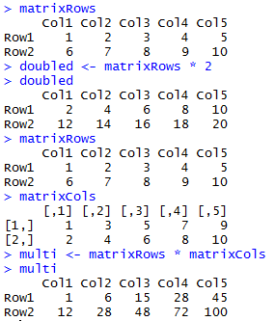
Matrix
You can easily perform regular arithmetic function on a matrix and it will create a new matrix with those values

Slide 32
Factors
Factors store categorical variables
A categorical variable is a variable that can only belong to a limited number of values
For example let’s say bachelor degree classes can only come as 1st, 2.1, 2.2, 3rd, and pass – that’s a categorical
The opposite is a continuous variable which can technical correspond to an infinite number of values

Slide 33
Factors
Within categorical variables you also have nominal and ordinal categorical variables
Nominal means that there isn’t an implied order whereas ordinal would have an order
For example, our bachelor degree levels factor has an obvious order and we can set this up when creating the factor
But if we had a factor of animal types – “Mammal”, “Bird”, “Reptile”, “Fish”, etc. There is no obvious ranking we can gives these, so they are nominal
Notes:
Worth noting that you cannot perform some operators on nominal factor since R wouldn’t be able to tell if Fish > Mammal
But if you set up the levels it could tell if 1st > 2.2

Slide 34
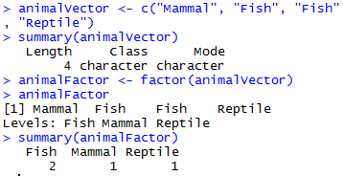
Factors
To create a factor you use the factor() function. First we need a vector of instances that belong to a limited number of categories, then you can create a factor from that. We can also get some summary statistics from the factor

Slide 35
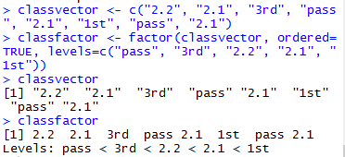
Factors
By default, R creates nominal factors, so to create an ordinal factor we have to specify some additional arguments
levels should present the values of the factor in the correct order
Now you could perform comparisons on these values

Slide 36
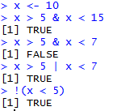
Logical operators
We’ve already seen a number of comparison operators in R such as <=, ==, and !=
You can also perform logical operators such as AND & OR | and NOT !

Slide 37
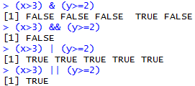
Logical operators
There is also the && and || statements which operate differently on vectors
These only return the value of the first comparison

Slide 38
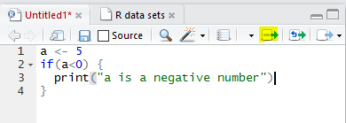
RStudio / Scripts
As our coding starts to get a bit more complicated it would be useful for us to be able to write these steps out in a script that we can rerun as necessary
Write steps out in a new file, highlight the steps you want to run, and press the button shown in the image
RStudio will run these commands in the console for you
Notes:
A useful tip – ctrl+L clears the console
Alternatively you can click the ‘source’ button which will run the whole file, 2 to the right of the highlighted button

Slide 39
Conditionals
Note that for R we need to encompass blocks of code in curly braces as demonstrated with the if conditional
If the condition within the parentheses () is true, then the code block will run
Notes:
A useful tip – ctrl+L clears the console

Slide 40
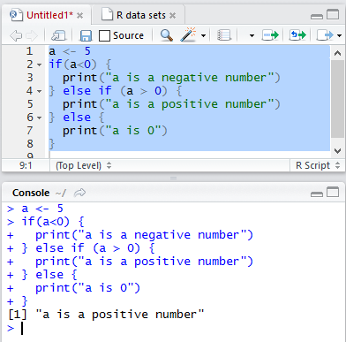
If/Else
Note that the else clause must begin on the same line of the closing if statement
R treats the initial if statement as ‘complete’ otherwise and doesn’t understand what you’re ‘else’-ing for

Slide 41
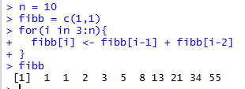
For
You can also create for loops to range over items in vectors or ranges
Notes:
WRITE

Slide 42
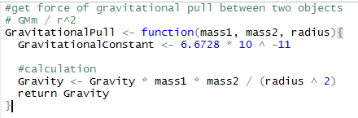
Functions
To create a new function you must use the function() keyword
You can then call this as GravitationalPull(10,10,10) by submitting parameters

Slide 43
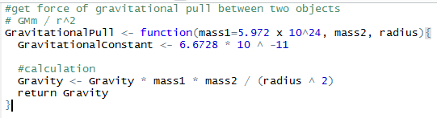
Functions
If, say, you knew that one of the objects was likely often going to be the Earth, you could set a default value for one of the mass values
If you ever want to know the arguments that a function needs, just type args(function_name)!

Slide 44

Functions
You can even pass functions to other functions, not just data
This can create even more powerful and flexible functions
Notes:
For example, with this we could sum, average, max – perform all sorts of different functions on different data quickly and easily

Slide 45

Anonymous functions
Anonymous functions are just functions that haven’t been given a defined name
This can be useful for quick functions that you don’t need to save for later
Notes:
Note – called lambda functions in Python
This would output 7 as the function is just x + 1, and x will be 6

Slide 46
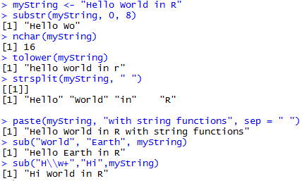
Text functions
There are loads of string functions in R, some of which may look familiar as they appear in most programming languages

Slide 47
Regex Functions
Like most languages, R has a suite of Regular Expression functions, that can be used to search through and manipulate text.
Regex is a language-agonistic way of describing a portion of text:
\\w locates any word
\\w+ locations one or more words
\\w* locations zero to many words
They are often more versatile when dealing with higher types compared to sub() and strsplit()

Slide 48
Ellipses
The interesting thing about the paste() function is that it’s first set of parameters is an ellipses (…) – this means there can be any number of arguments, which is useful as we may not know how many strings a user wants to concatenate
The ellipses can be very powerful, but bear in mind any arguments that come after the ellipses must always have a default value, anything that come before can have a default value but don’t have to

Slide 49
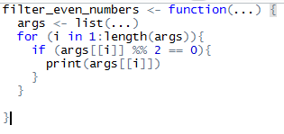

Ellipses

Slide 50

R Libraries
R has many packages available for you to use
First you must install the package (one time only)
Then load the required libraries (at the start of every session)

Slide 51
R Libraries
A lot of R’s capabilities and extensibility comes from its packages
Before you try to manually write something yourself, try and see if there’s a package for it
CRAN, the packages contributed to R, has nearly 10,000 different packages available

Slide 52

Working directory
R has the concept of a working directory which means you can have relative paths when pointing to external files

Slide 53

Importing
Of course, a lot of data we want to work with won’t be already contained within R – we will need to import it!
Notes:
These are all essentially variants of each other
read.table – top level
read.delim – starts with the separator set to tab, header set to TRUE, etc
read.csv – separator set to comma, header set to TRUE etc
Header – first line will be taken as column names

Slide 54

Exporting
And of course at other times we will want to write data out as well

Slide 55
…and Python
Python
Allows greater flexibility
Offers many libraries, not just ones for data science
Continuously adding more in the data science space
R
Has always been used for analysis, purpose built
Many libraries for support
Strong data analysis community

Slide 56
…and Python
A lot of people think you have to choose one or the other
You can actually integrate them, either using in-built packages to create instances of R in Python or the other way round
Or you can simply run a script from one in the other
Or you could just set up an analytics pipeline that will go through one then the other e.g. do some cleaning in Python then analytics and graphing in R!

Slide 57
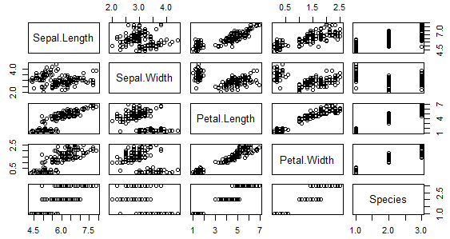
Plotting
R has a large range of functionality already built in with regards to plotting
Earlier we saw an example of quickly putting together a plot, plot(data) can be a good way of quickly picking out possible trends but can get messy easily
Notes:
plot(iris)

Slide 58
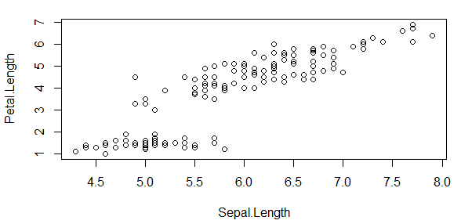
Plotting
Instead, we’ll get a bit more specific for a clearer view
Notes:
plot(iris)

Slide 59
Plotting
You can just plot vectors against each other and specify plot(v1, v2)
With data frames we either need to specify the data value (pointing to our dataframe) and then which of the columns from that we want to plot, OR, we can just refer to the columns we want to plot using the $ sign

Slide 60

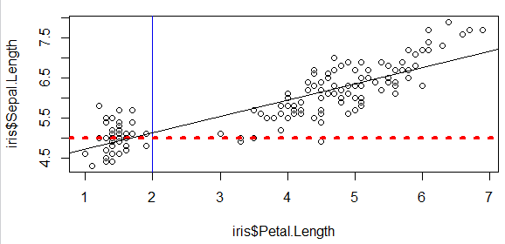
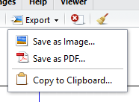
Plotting
We can add additional lines to our plot as needed with the abline function, these lines are also customisable
Notes:
v or h basically mean the x or y interceptor depending on if it is a vertical or horizontal line, lty means line type (see online for available types), lwd means line width (a higher number is a higher width, 1 being default)
Col means colour, colors() will return all colour types available
lm stands for linear model, essentially creates a straight line of best fit for us (be wary of the order you add the variables)
You can easily save plots using the Export function or by running the appropriate command pdf(“plotfilename.pdf”), or png, jpeg, etc

Slide 61
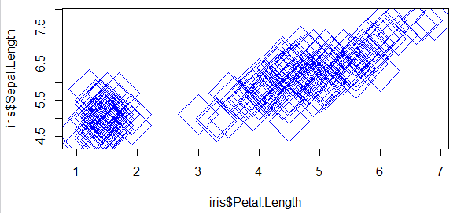
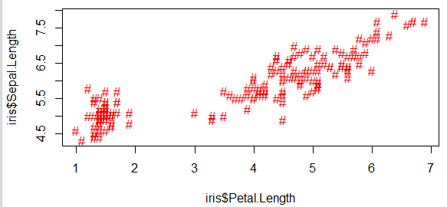
Plotting
We can customise how our data appears on the plot as well
Notes:
pch is our plot point type, there’s a huge range so have a look online, experiment, or type ?pch on the console
Some can just be characters e.g. #, others are shapes denoted by numbers
Some shapes are filled in and others aren’t

Slide 62
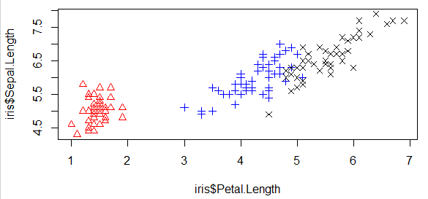
Plotting
We can even change it based upon another data point in our data frame
Notes:
Square brackets [] denote which other plot point we want to separate our data into

Slide 63
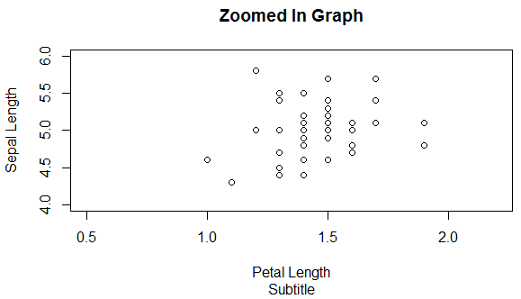
Plotting
We can update titles, labels, and even the x and y axes limits
Notes:
Note that this only shows the bottom left of the graph we have seen previously

Slide 64
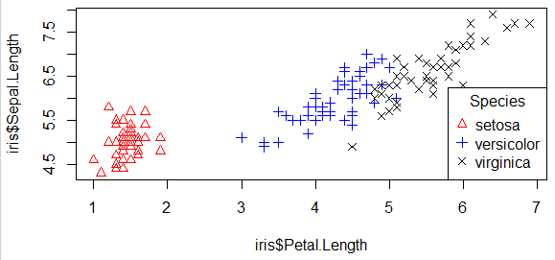
Plotting
We can also add a legend with lots of customising options
Notes:
You can specify where the legend is by using locator(1) which allows you to click where you want it to be, you can give it an x,y coordinate, or you can give it a text string along the lines of topleft, right, center, etc
Again, lots of options, just type ?legend on the console to see what you can do

Slide 65

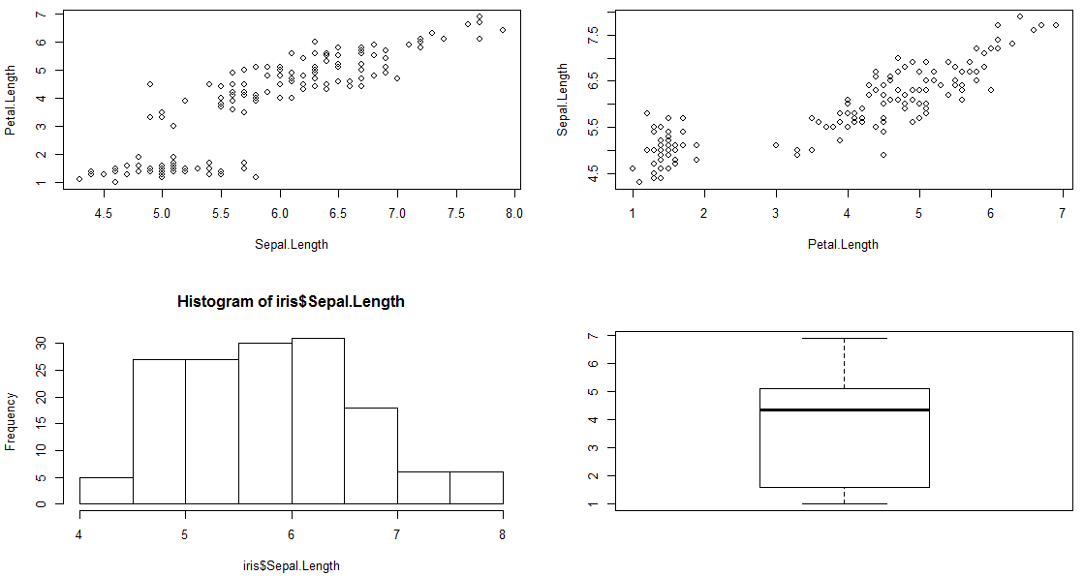
Plotting
We can also display multiple graphs at once
Notes:
You can use mfrow() or mfcol(), that will only affect how the columns are filled with the graphs essentially
Can also use layout() which works slightly differently
Remember you can use ?function_name whenever you want to know more about how something works
par() basically sets up parameters for a session, if you no longer want them to be active, simple type dev.off() and start again!

Slide 66
Plotting
You can do a huuuuge range of other things just with the simple plot() function like changing fonts, background colour, font colour etc
If you type help(par), R will give you a list of possible parameters to change on plots among other things
But for now we are going to move on to exploring a few other types of plots
Don’t forget, there are lots of packages out there that might help in addition!
Notes:
Like word clouds, heat maps etc

Slide 67
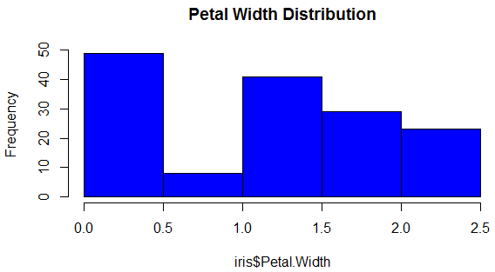
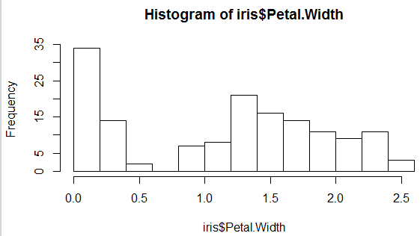
Plotting, histograms!

Slide 68
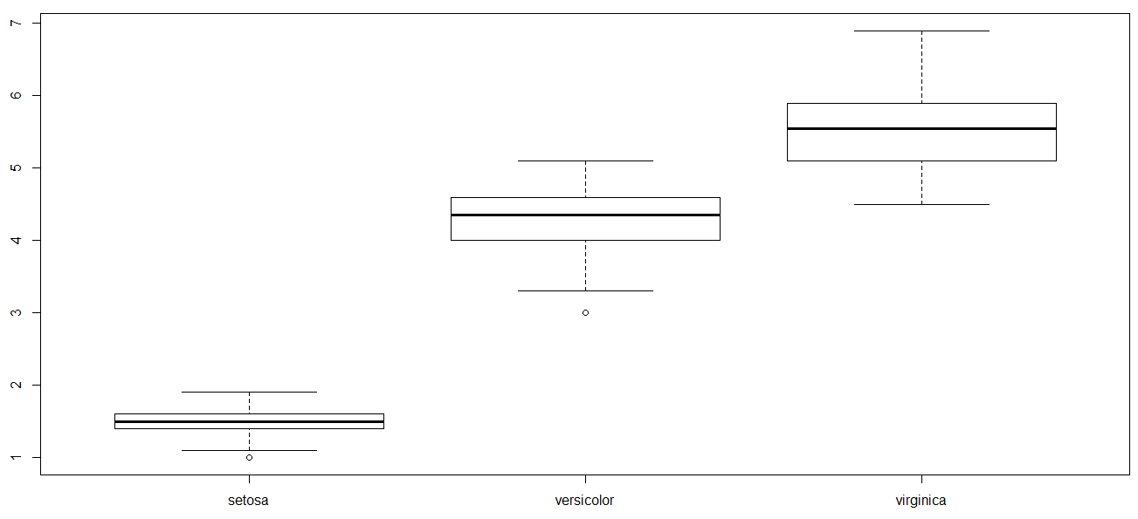
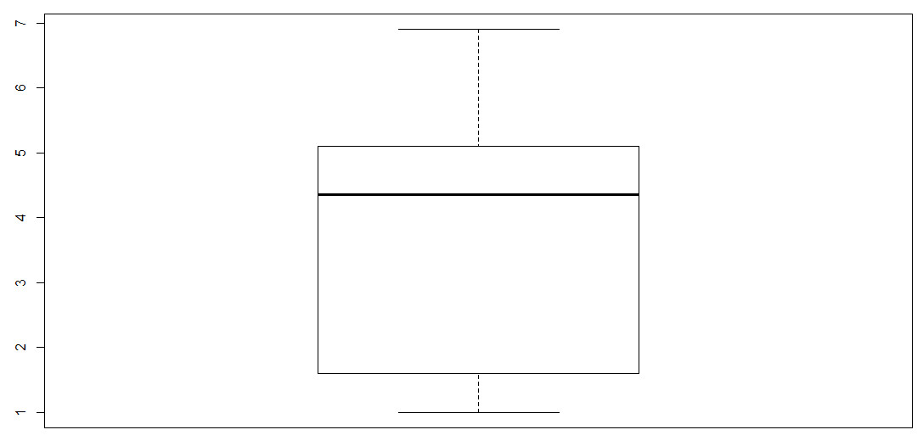
Plotting, boxplots!

Slide 69
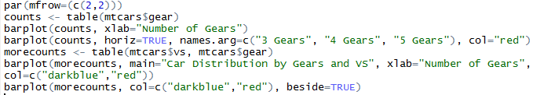
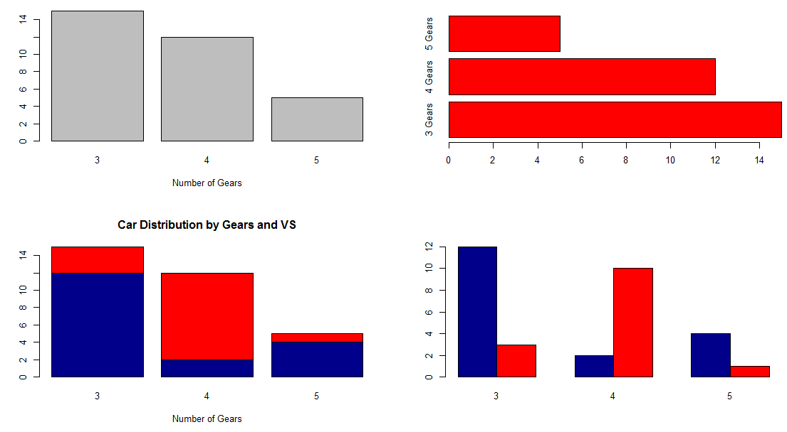
Plotting, barplots!!
Notes:
Sadly the iris data doesn’t lend itself well towards barplots so we have used an expanded car dataset here called mtcars

Slide 70

Plotting, pie charts!
Pie Chart of Iris

Slide 71
Plotting
Line charts! The thing with line charts is you need a plot area first, then lines() draws the specified lines on top of that
So we could create a regular plot() graph with our data points then write a line chart over the top
Alternatively we can specify the plot() function not to plot the data points, then we just add the lines on their own over the top
Notes:
The iris data also doesn’t lend itself too well to line charts either

Slide 72


Plotting
Notes:
The iris data also doesn’t lend itself too well to line charts either

Slide 73
Predictions
A useful outcome from data analytics is some form of prediction e.g. ‘will this person buy our new product?’, ‘where will houses be worth the most in 10 years time?’, ‘what will be the hottest meme of 2017?’
Predictions are generally made on some data we already have and we create an estimation of answers to these questions using this
We’ll go through an example to explore the ways we can do this

Slide 74
Predictions
A popular dataset for learning prediction analysis is based on the survival rates of passengers aboard the Titanic
We have two sets of data, both of which contains details on the passengers such as name, age, gender, etc… but only one of them includes whether that passenger survived
Our task is to predict the survival rates of those in that file

Slide 75

Titanic example
As the data is a csv we can easily read it in using read.csv()
You can then see it appear in the environment variables – if you click on the table image you can preview the data
Notes:
Note that you can also use the File -> Import Datasets -> From csv… commands but these use a different package called readr

Slide 76

Titanic example
Now let’s start exploring it in the console
First, let’s just view the structure of the data
What kind of data is held within our file?

Slide 77
An aside on Factors
Notice that in the data we’ve imported that there are no character variables – only Factors
This is fine as we can change back any of them that we don’t want as Factors later
However if, on import, you would prefer them all just to be characters then you can import them as such by adding the argument stringsAsFactors=FALSE
Notes:
Note that a number of these variables would be useful as Factors so we have left it as such

Slide 78

Titanic example
The table() and prop.table() function can immediately give us some insight into the distribution of our data that works particularly well for columns that could be distributed as some kind of factor
Notes:
Even just from this we can start predicting outcomes
For example, only 38% of people survived from the training set
We could, morbidly, predict that everyone dies and we would still be mostly right….

Slide 79

Titanic example
We can extend the prop.table() function to take more than one variable and start exploring some associations
Notes:
In predicting data, sometimes it’s useful to begin by exploring our gut instinct or prior knowledge
The titanic disaster is famously known for saving ‘women and children first’
1 means they survived, 0 means they perished
You will often find factor data stored as numbers instead of strings – it saves space and makes it easier for a number of built in packages to analyse
What is the 1 doing in the second command?
It means the calculations will be performed row wise – that is, the proportion of each sex that survived in separate groups rather than in total
In the first we could see that the highest proportion that perished were still male, but this may not be as obvious with other statistics, and the second results give us a better insight. For example – 81% of males perished vs 50% of the total people perished and were male
It also shows much more clearly that the majority of females survived
We could now create a more accurate prediction of ‘all males perish, all females survive’

Slide 80

Titanic example
We can also create some simple plots to explore our data early on
Notes:
The actual values are less clear but the proportions can be much more obvious

Slide 81

Titanic example
So if we wanted to write out this current prediction to a new test file we can just do the following
Notes:
First we read in our test file – the data that doesn’t have information on whether the passenger survived
Then we create a new column for it called Survived and fill it with 0s
Then for anything that has the Sex of female we set the Survived column to 1 to indicate they survived
Finally we write the resulting data set to a new csv file

Slide 82
Titanic example
So far, we have mostly been merrily playing with data in the hopes of seeing what it returns to us based on a hunch
Time to get a bit more rigorous
First, let’s reassess the columns we have and the data they contain

Slide 83
Titanic example
Columns that we aren’t going to focus on:
PassengerId – unique for each passenger
SibSp & Parch – could be useful but for now we shall ignore
Ticket – unique
Fare – very spread out, this could be largely inferred from Pclass but could be used
Cabin – quite unique, could be useful as lower decks probably less likely to survive
Embarked – could be used as it is already in a simple factor

Slide 84


Titanic example
Passengers in 3rd class seem to have a much lower survival rate even if they are the majority

Slide 85

Titanic example
We can combine this information with other variables using the aggregate function

Slide 86
Titanic example
Name might seem like an odd column to highlight since everyone’s name is unique, but each name does have a non-unique and potentially useful bit of information – the passenger’s title
Titles can suggest a wealth of information such as age and wealth, which could strengthen our hypothesis of rich/child/female having a higher survival rate than others

Slide 87

Titanic example
We will start by extracting the Title value into it’s own column and examining that

Slide 88

Titanic example
There’s quite a few values that have very few associated passengers so we will incorporate these into some of the other classes
Notes:
Since this is also going to be a limited set of values we could ensure this is set up as a factor by running train$Title = as.factor(train$Title)

Slide 89

Titanic example
This adds tons more context to our prediction
Females are still far more likely to survive in general, but if they had a high status they were even more likely to survive
While males still have a low survival chance, it improves if they were of a high status, and even more so if they were young
Notes:
One last useful step would be to turn this back in to a factor
train$Title <- factor(train$Title)
It’s also interesting to observe that, while all with the Lady title survived from females (presumably due to status), you were more likely to survive as a Mrs than a Miss
You could infer this as Mrs being more likely to have family with them since they were likely wives/mothers, and the Miss group has a huge range of ages from 4 to 63. Perhaps this is indicative that we should take into account family sizes as well?

Slide 90
Titanic example
Finally, we really need to look at age
It’s a tricky one concerning our data, as there is a lot of data missing, but it could provide valuable insights
A simple approach would simply be to fill each missing value with the average of all the passengers
However we have some different information we can average it over now – those titles we made earlier

Slide 91

Titanic example
Notes:
Bear in mind that this model will fit some groups more than others – remember that Miss had a large range of ages
If we wanted to do this properly we should also apply it to the test dataset and get the range of ages from there based on title!
And if we really, really wanted to we could predict everyone’s ages using a decision tree! ☺

Slide 92
Titanic example
Decision Trees
We are going to use the rpart package (recursive partitioning and regression trees)
rpart will create a model for us based on our training data which we can then apply to the test data to make predictions
We’ll use a number of other packages to create some nice plots to visualise the fit as well
Notes:
Classification tree as the return value is categorical
There are lots of modelling packages for R – this is just one of them
We could even use decision trees to fill in those NA age variables instead of the way we did already! You would have to use the ‘anova’ method though as this is the continuous variable method

Slide 93




Titanic example
Notes:
fancyRpartPlot(fit)
Note how different variables have different effects on the outcome
However, the farthest left and right leaves still remain the same regardless
All men over 6.5 years of age will be modelled as perishing
All women in Pclass 3 will be modelled as surviving
We could have all the other data points in one fit but this would take longer to calculate and sometimes wouldn’t have the effect we want – it’s easy to overfit

Slide 94


Titanic example
The rpart function also gives us the ability to override the variables that determine the minimum number of variables in a bucket before it splits (minsplit), and the complexity (cp) parameter that determines which splits are important
Be wary of overfitting…
Notes:
Complexity is related to whether R thinks it’s worth splitting the branch further, it must increase the accuracy by the complexity value, else it will not bother
0.01 is default complexity

Slide 95
Titanic example
Once we have a fit we’re happy with, we can apply it to the data we are trying to predict
For this we need to make sure we’ve applied the same level of feature engineering and NA value replacement as the training set
You can combine the datasets together and do it at the same time earlier in the process
The predict function will return the values of Survived for our test data

Slide 96
Titanic example
Random Forests
A forest is a collection of trees – both literally and in R
Each tree will vote on the outcome of passengers, and the forest will deliver the result of the majority
We need to introduce a bit of randomness though, since the formula for producing a tree is the same every time, and there are a couple of ways we can do this…

Slide 97
Titanic example
Bagging – takes a random sample from the data with replacement
This way, any strong variables in our dataset should still shine through, but will introduce a bit of randomness for weaker ones
This can mean that the strong features dominate our prediction too much…
Notes:
On average, 37% of rows are omitted

Slide 98
Titanic example
The other way is that Random Forests take a subset of the available variables (usually around the square root of the total)
This way, some trees won’t even come across those stronger variables until much further down the branches

Slide 99
Titanic example
In Random Forests, the trees are grown out fully and therefore each one individually will overfit
However, by combining them together, we should be able to cancel out the mistakes of each tree by taking it to the majority vote

Slide 100

Titanic example
Before we can make a Random Forest we’ll need to fix a couple of things in our dataset. Trees can cope with a few missing values, but Random Forests can’t.
We did some of this earlier when we filled out any NA values for age
This is generally called data cleaning
Embarked still has some NA values so we’re just going to fill the empty strings as S since it’s the most popular boarding point

Slide 101

Titanic example
We can then create our fit quite similarly to how we did before, but note that instead of adding a method type we simple force Survived to a factor
The importance set to TRUE means we’ll measure another factor which should tell us how ‘important’ a factor is towards our fit (that is, how much of an effect it has)
Notes:
Plotting is a useful way of checking which factors are going to have the greatest effect on our test even with the randomness introduced
Once again, the predict will return just values for the Survived column for our test data

Slide 102
ggplot2
http://databall.co/shiny/shinyggplot/

Slide 103
Thank you
QA hopes you enjoyed your course,
as much as we enjoyed teaching you.

